Slide 1
SEBI Case Study: Why Do 90% of Retail Traders Lose Money in the Stock Market?
A Data-Driven Root Cause Analysis
Scope
SEBI F&O Retail Trader Loss Analysis — Case Study covering Root Cause Analysis, Pareto Insights, Executive KPIs, KPI Analysis and Strategic Recommendations and Outcome Monitoring
89%
₹1.1L
Retail F&O traders incur net losses annually
Average annual loss per individual trader
7
80%
Distinct root causes identified via MECE framework
Of losses driven by just a handful of behaviours
Prepared By
Rajesh Keshri

Slide 2

BUSINESS PROBLEM
Despite Rising Market Participation, Retail Traders Are Losing at Scale
Despite increasing participation in India's capital markets, a significant majority of retail traders incur losses, particularly in the Futures & Options (F&O) segment. The pattern is systemic, repeatable, and data-substantiated by SEBI's own research.
Key Findings
Objective
Identify the key drivers behind retail trading losses and recommend data-driven, actionable solutions that improve long-term trading outcomes for individual participants.
Nearly 90% of retail F&O traders lose money on a net basis after accounting for transaction costs.
A small percentage consistently earn profits — suggesting edge is achievable but structurally rare.
Methodology
High trading frequency and excessive leverage are among the strongest predictors of amplified losses.
Transaction costs — brokerage, STT, and slippage — further erode already thin margins.
MECE Root Cause Framework · Pareto (80/20) Analysis · Behavioural Pattern Mapping · KPI Definition

Slide 3

ROOT CAUSE ANALYSIS
~91% of Retail Traders Generate Negative Net Returns
SEBI Reference: 89% of individual F&O traders incurred losses, with average annual losses of approximately ₹1.1 lakh per trader.
1. No Clear Trading Plan
2. Poor Understanding of the Market
Trading without a proven and tested approach
Not fully understanding what is being traded
No clear rules for when to buy, sell, or exit
Strategies are not backtested before using real capital
Decisions based on guesses rather than data
Frequently changing strategies without sufficient evidence
Limited understanding of company fundamentals and valuation
Misuse of charts and technical indicators
Limited grasp of options, leverage, and complex products
Failure to recognise changing market conditions
3. Emotional Trading
4. Poor Money & Risk Management
Making decisions based on emotions instead of the plan
Taking more financial risk than the trader can handle
FOMO buying as prices rise and others profit
Panic selling when prices fall sharply
Holding losing trades on hope of recovery
Revenge trading — increasing risk after a loss
Investing capital that cannot afford to be lost
Over-concentrating in a single trade or stock
Using excessive borrowed money or leverage
No defined stop-loss or maximum drawdown limit
5. Poor Trading Discipline
6. High Cost of Trading
Knowing what to do but failing to follow it consistently
Costs that gradually reduce trading profits
Ignoring planned stop-losses or exit rules
Taking too many unnecessary trades
Entering trades without proper preparation
Failing to review and learn from previous trades
Brokerage, taxes (STT, GST), and other charges
Slippage losses from unfavourable execution prices
Frequent trading amplifying total cost burden
7. External Market Risks
Factors outside the trader's direct control
Sudden crashes or unexpected price movements
Economic, political, or global events
Market manipulation and social-media misinformation

Slide 4
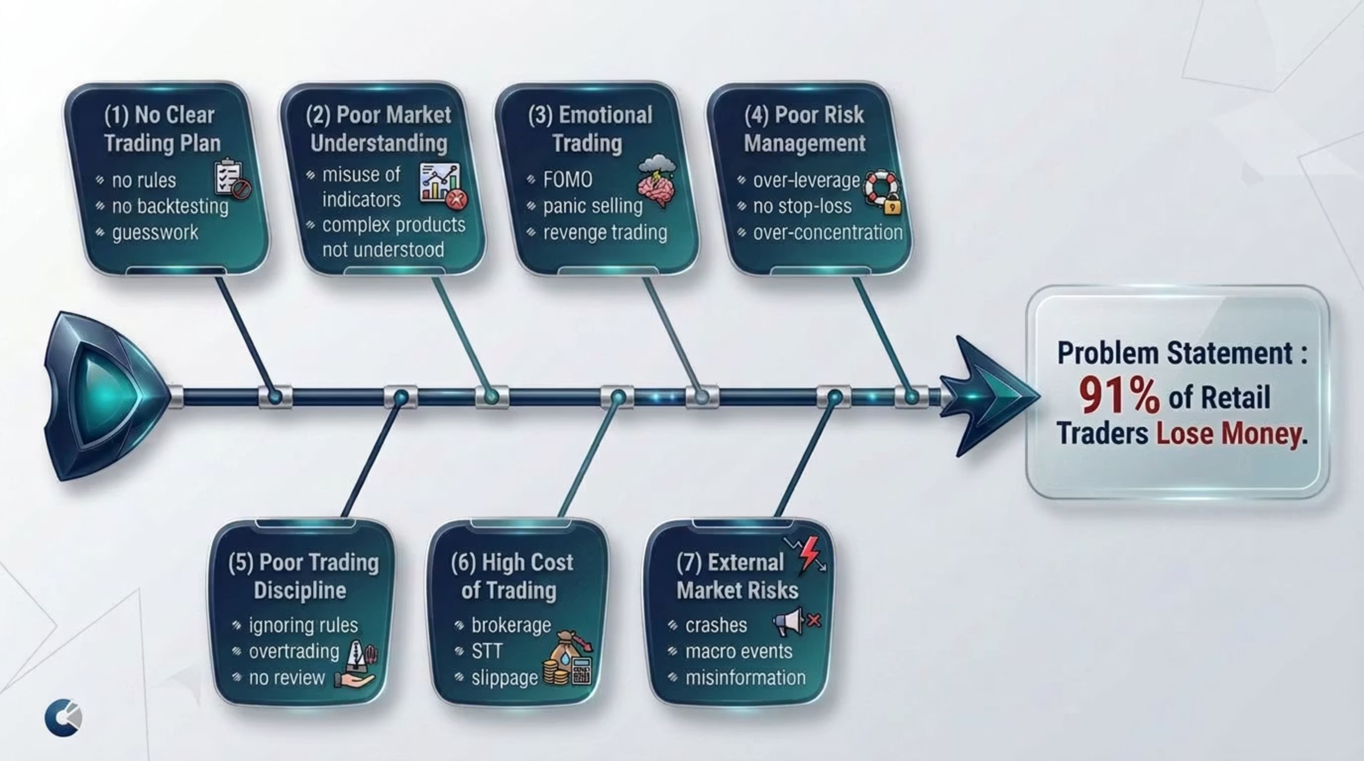
MECE FRAMEWORK
Seven Root Causes of Retail Trading Losses
The following MECE tree decomposes the core problem — negative net returns for ~91% of retail traders — into seven mutually exclusive, collectively exhaustive root causes. Each cause is independently actionable and collectively accountable for each Major KPIs

Slide 5
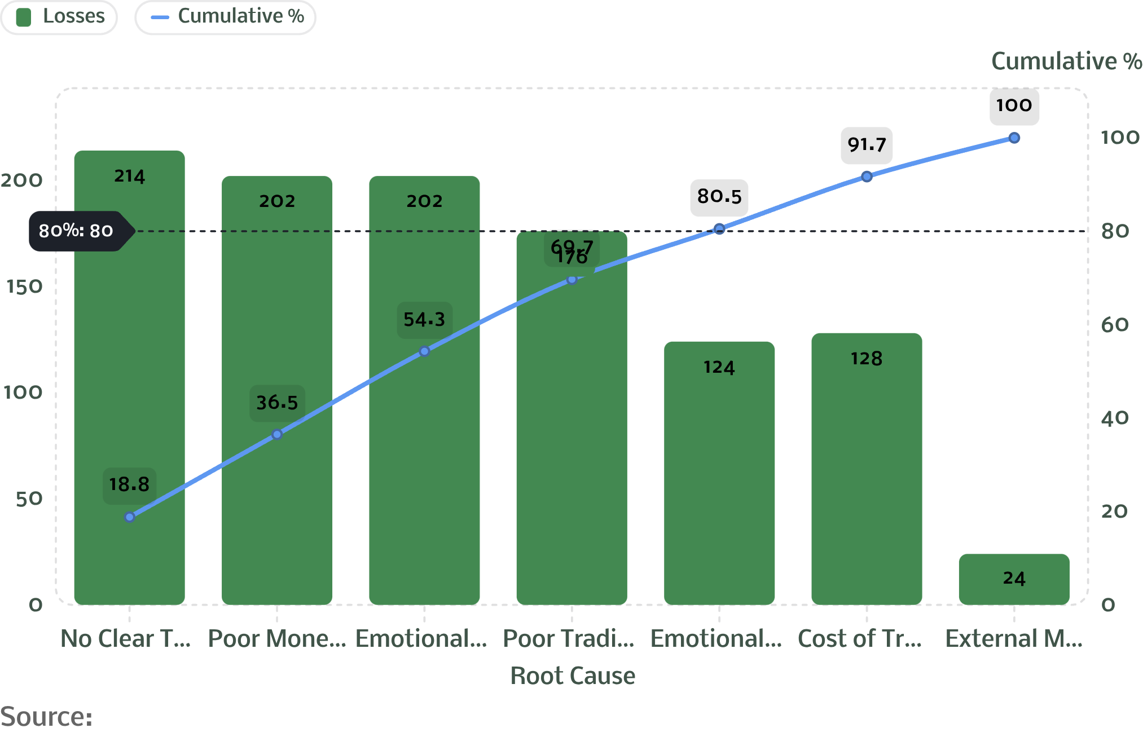

PARETO ANALYSIS
80/20 Rule: A Small Number of Causes Drive the Majority of Losses
Approximately 80% of trading losses are attributable to five dominant causes. Addressing these few factors can produce disproportionately large improvements in trader outcomes.
Pareto Chart: Trading Loss Causes
Key Insight
The major contributors are:
No Clear Trading Plan
Poor Money & Risk Management
Trading Discipline
Emotional Trading
These causes account for approximately 80% of overall defects makeshould be prioritized for corrective and preventive actions.
Priority Intervention Order
No Clear Trading Plan
Poor Money & Risk Management
Trading Discipline
Emotional Trading
Trading Plan × RISK–REWARD → TRADING OUTCOME
Accuracy tells us how often we are right; Risk–Reward tells us how much we make when right. Both must be analysed together.

Slide 6

A/B TEST SIMULATION
A/B Test: Accuracy vs Risk-Reward
Same win rate, different win size — different outcome.
Fixed Conditions
₹10,000 capital | 252 trades | ₹200 risk per trade | 1:1 risk-reward ratio
Scenario A — 30% Accuracy
Scenario B — 50% Accuracy
76 wins | 176 losses
76 × ₹200 = ₹15,200
176 × ₹200 = ₹35,200
LOSS: ₹20,000
126 wins | 126 losses
126 × ₹200 = ₹25,200
126 × ₹200 = ₹25,200
BREAK-EVEN: ₹0
Improvement: +₹20,000 vs Scenario A
Key Takeaway
Higher accuracy improves results.
50% accuracy with 1:1 risk-reward only breaks even.
Profit needs more than accuracy alone.

Slide 7
A/B TEST SIMULATION
A/B Test: Does Win Size Matter?
Same win rate, different win size — different outcome.
Fixed Conditions
₹10,000 capital | 252 trades | ₹200 risk per trade | 30% win rate
Scenario A — 1:1
Scenario B — 1:3
76 wins × ₹200 = ₹15,200
176 losses × ₹200 = ₹35,200
LOSS of ₹20,000
76 wins × ₹600 = ₹45,600
176 losses × ₹200 = ₹35,200
PROFIT of ₹10,400
Key Takeaway
Same win rate, different win size = different result.
₹200 wins per trade lose money.
₹600 wins per trade turn the setup profitable.

Slide 8

BEHAVIOURAL ANALYSIS
Behaviour vs. Profitability: Four Critical Relationships
The data reveals clear, directional relationships between specific trader behaviours and profitability outcomes. These are not correlations alone — they represent causal pathways supported by SEBI's own research findings.
↑ Trade Frequency
↑ Leverage Usage
→ Lower Net Profit
Each additional trade increases total cost burden (brokerage, STT, slippage) while the probability of adverse outcomes compounds. High-frequency retail traders consistently underperform low-frequency counterparts on a net basis.
→ Higher Drawdown
Leverage amplifies both gains and losses symmetrically — but behavioural biases mean traders hold losing leveraged positions longer and exit winning positions too early. Result: asymmetric downside exposure.
↑ Emotional Decisions
↑ Risk Management Quality
→ Reduced Consistency
FOMO-driven entries and panic-driven exits produce erratic trade timing. Emotional traders systematically buy high and sell low, inverting the fundamental premise of profitable trading.
→ Higher Long-Term Success
Traders who define position size, set stop-losses before entry, and respect maximum drawdown limits demonstrate significantly improved survival rates and long-term return consistency.
The profitable minority — roughly 11% of retail F&O traders — are distinguished primarily by disciplined risk management and lower trading frequency, not superior market prediction ability.

Slide 9

PERFORMANCE MEASUREMENT
KPIs to Monitor Trading Health
Sustainable improvement in trading outcomes requires objective, measurable performance indicators. The following three KPIs provide a comprehensive view of trading quality, risk discipline, and capital preservation over time.
1
2
3
Optimised Constant Trading Strategy
Average Risk-Reward Ratio
Maximum Drawdown Month-on-Month
The ratio of potential profit to potential loss for each trade, measured consistently across the trading journal. A ratio above 1:2 (risking ₹1 to make ₹2) provides a structural edge even with a sub-50% win rate. This KPI monitors whether trades are being entered with a positive expected value.
Target: Maintain average Risk:Reward ≥ 1:2 across all positions.
A standardised, rules-based trading strategy that is rigorously backtested and applied consistently across market conditions. This KPI measures strategy adherence rate — the percentage of trades executed strictly in line with the defined plan, without discretionary deviation.
Target: ≥90% plan adherence across all executed trades per month.
The peak-to-trough decline in trading capital within each calendar month. Monitoring drawdown MoM ensures that a single bad period does not permanently impair capital. This is the primary capital preservation metric and the earliest warning signal of strategy breakdown or emotional trading episodes.
Target: Maximum monthly drawdown capped at ≤5% of total trading capital.

Slide 10





RECOMMENDATIONS
Strategic Recommendations: Five Pillars of Improvement
Based on the root cause analysis and Pareto prioritisation, the following five interventions address the highest-impact loss drivers. These are sequenced for practical implementation.
Risk Management
Reduce Overtrading
Trading Journal
Limit risk per trade to ≤1–2% of capital. Define stop-loss level before entry — not after. Never move stop-losses to accommodate hope.
Focus exclusively on high-quality, pre-defined setups. Avoid impulsive trades driven by intraday noise or social-media tips. Fewer, better trades outperform frequent, reactive ones.
Record every trade — entry, exit, rationale, emotion at the time, and outcome. Analyse patterns of mistakes monthly to drive measurable improvement in decision quality.
Structured Market Education
Performance Review
Fully understand derivatives mechanics before trading them. Study position sizing, probability of ruin, and expected value frameworks. Knowledge precedes capital deployment.
Weekly review of trade execution quality. Monthly KPI tracking across Risk-Reward, drawdown, and strategy adherence. Continuous feedback loop drives compounding improvement.

Slide 11
EXPECTED IMPACT
If Recommendations Are Followed: Expected Outcomes by Time Horizon
The interventions outlined are not theoretical — they address the measurable, data-backed root causes of retail trading losses. Implementation across three time horizons produces compounding benefits.
Short Term
1
Lower losses from immediate application of stop-loss discipline and leverage caps.
Better discipline through structured trade planning and journal adoption.
Reduction in impulsive, emotion-driven trades within the first month of consistent practice.
2
Medium Term
Improved consistency as strategy adherence rates increase and behavioural patterns stabilise.
Better risk-adjusted returns as the Risk-Reward ratio improves and drawdown events decrease in frequency and severity.
Trading journal insights begin to surface repeatable edge opportunities.
Long Term
3
Sustainable profitability built on process repeatability rather than market prediction.
Reduced emotional decision-making as systematic protocols replace reactive behaviour.
Enhanced capital preservation — compounding works in the trader's favour when drawdowns are controlled and gains are allowed to run.
≤2%
1:2
≤5%
Risk Per Trade
Min Risk-Reward
Monthly Drawdown Cap
Recommended cap to limit single-trade damage
Structural edge even below 50% win rate
Capital preservation guardrail MoM

Slide 12





FINAL TAKEAWAYS
Conclusions: Trading Success Is a Process Problem, Not a Prediction Problem
The evidence from SEBI's data is unambiguous: most retail trading losses are driven not by market unpredictability alone, but by a concentrated set of controllable behavioural and structural failures.
Poor Risk Management
Excessive Leverage
Emotional Decision-Making
The single highest-impact lever — defines survival in markets.
Amplifies losses asymmetrically; the most common path to account destruction.
FOMO and panic systematically invert rational trade timing.
Overtrading
Transaction Costs
Increases cost drag while reducing signal-to-noise in decision-making.
Silently erode profitability; compounded by high-frequency behaviour.
"Success in trading is less about predicting the market and more about managing risk, maintaining discipline, and following a well-defined process."
The Profitable Minority Do This Differently
Prepared By
The ~11% of retail traders who generate consistent profits are not better at forecasting. They are better at process adherence, loss limitation, and emotional regulation. These are learnable, measurable skills — not innate talent.
Rajesh Keshri
Data Source
SEBI Study on Profit and Loss of Individual Traders in Equity F&O Segment — Securities and Exchange Board of India

